Slide 1
Empowering Voters.
Defending Democracy.
Notes:
We are nonpartisan, we never support or oppose parties or candidates. Our mission is to educate, inform and advocate.

Slide 2
To Become a Member:
my.lwv.org/texas

Slide 3
Redistricting
Is one of the most important processes in our democracy, because it determines the power of your vote.
Notes:
The way the district boundaries are drawn determines how your community is represented, which other communities are included in your district, and ultimately, who will be elected to represent you. Decisions are then made by those elected leaders that affect what kind of air you breathe, the water you drink, the quality of your child's school, and how much you're going to pay in taxes.

Slide 4
Why do we need districts anyways?
Notes:
Why do we need districts anyways?
I want everyone to drop themselves back in time and imagine that they are setting up a town in west TX in the 1800s. What are some of the first things that you are going to need to find: maybe a water supply, a way to build houses and a way to grow food. Soon enough, maybe you have a line of transportation come by, like the railroad. Then grocery stores, businesses, and schools show up, and soon enough you have a town with a shared culture. This is what we refer to as a community of interest, and this community will need to have a cohesive voice of representation in order to advocate for shared needs and resources in their community.

Slide 5
What Are the Rules for Redistricting?
Federal Guidelines
Equal populations: one person, one vote
VRA requirements: cannot dilute the power of minority representation (racial gerrymandering)
State Guidelines
State House districts: County Line Rule
TX Senate districts: must be single member and contiguous, but no requirement for compactness
Notes:
There are surprisingly few guidelines for redistricting:
Federal Guidelines:
One person, one vote: In 1964, in Wesberry v Sanders and Reynolds v. Sims, SCOTUS ruled that districts should have relatively equal populations.
According to the Voting Rights Act (VRA), states must not dilute the voting power of minority groups or enact voting laws that discriminate against racial and language minorities.
State Guidelines in TX Constitution:
State House Districts must follow the County Line Rule, which prohibits the division of counties between districts when population permits. (In other words, if there is enough population in a county to fit a whole district, then that district must be completely contained within that county.) Because of this law, there is less gerrymandering in the state house maps.
Neighboring counties in the same district must be contiguous (or touching).
There is also a requirement in our state constitution that the State Senate districts be single-member, and they must be contiguous.

Slide 6
How is the current process so bad?
Notes:
So where has the process gone so wrong?

Slide 7
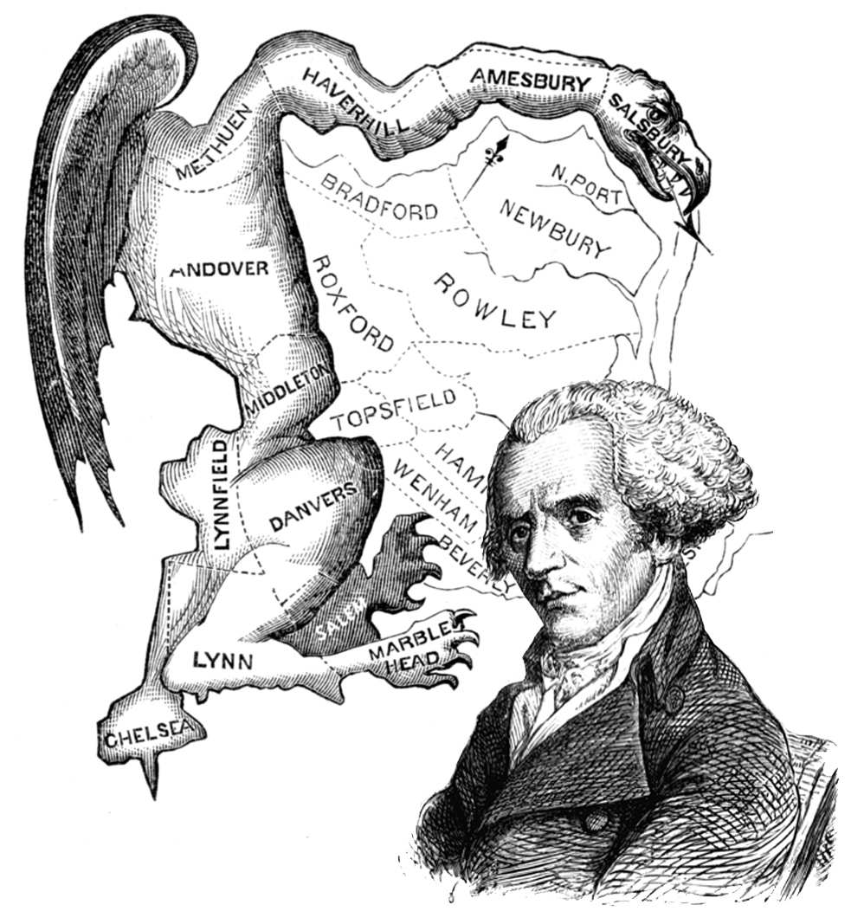
Gerrymandering: Redistricting Gone Wrong
The practice of drawing district lines to favor one group of people over another.
Partisan
Racial
Redistricting v. Gerrymandering
Is the purpose of redistricting to facilitate a representative democracy or to improve a partisan advantage?
Notes:
Gerrymandering is essentially redistricting gone wrong. It refers to drawing districts in such a way that it favors one party or group of people over another. There are two types: racial and partisan.
Racial gerrymandering was outlawed by enactment of the VRA in 1964, while partisan is still allowed.
The problem is that race and partisanship often go hand in hand, so you can’t have partisan gerrymandering without racial gerrymandering. According to recent PEW analysis, African American communities overwhelmingly support democratic candidates (90-95%), and hispanic communities also support democratic candidates (70-75%).
But keep in mind that Texas is a repeat offender when it comes to discriminating against minority groups. BOTH Democrats and Republicans have been found guilty in the past.
Also keep in mind that we are walking into the 2021 redistricting cycle without the same protections that we had during the 2011 round of redistricting. In 2013, the Supreme Court struck down a key provision of the Voting Rights Act, Section 5, that defined which jurisdictions should be under preclearnace. Areas that are under preclearance have to get any changes to their election laws approved by a federal authority, including changes in district maps. With this provision gone, extreme partisan gerrymandering is more likely to turn into racial gerrymandering.

Slide 8
Translate Into An Advantage
TEXAS U.S. Congressional Districts
D 3rd Party R
47% of Votes 2.6% 50.4% of Votes
2018
Votes Cast
VS
Seats Won
37% of Seats 63% of Seats
D 3rd Party R
49.9% of Votes 2.3% 47.8% of Votes
1992
70% of Seats 30% of Seats
Notes:
The whole purpose of gerrymandering is that the maps must translate into an advantage. In the 1990s, TX democrats enacted the 3rd worst gerrymander in modern U.S. history. The captured 50% of the vote in congressional races, yet they won 70% of the seats. After Republicans won every statewide election in 2003, they decided to have a mid-census redistricting and redrew the maps in their favor. Ever since then, Republicans have controlled the redistricting process. In 2018, Republicans captured about 50% of the vote, yet they won 63% of the seats. That means democrats are short about 3-4 congressional seats.

Slide 9
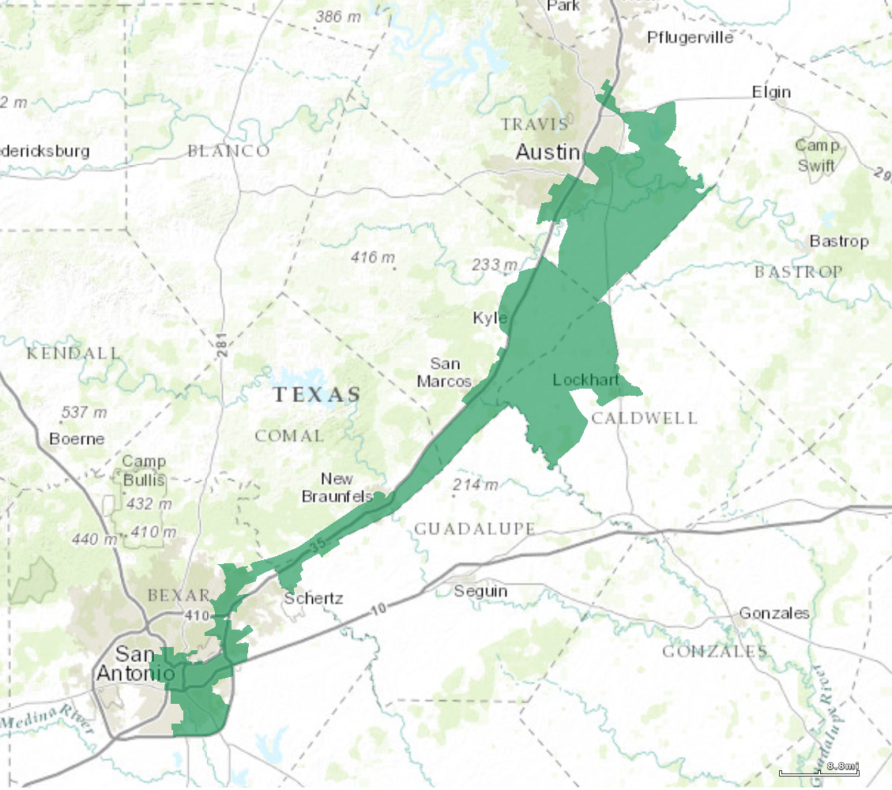
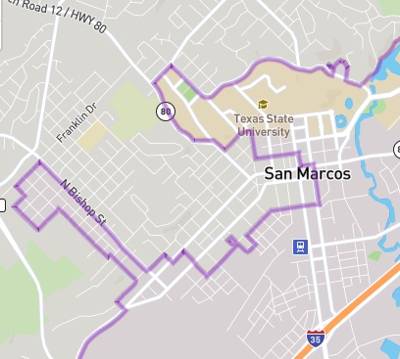
How Are These Maps Drawn?
Legislators consult with data analysts, state party officials, and special interest groups
They meet behind closed doors and do not have to consider the public’s input
They use partisan and demographic data to go block by block and choose their voters
U.S. Congressional Dist. 35
San Marcos, TX
Notes:
Legislators consult with colleagues, party officials, lobbyists & special interest groups. They meet behind closed doors, and, because of partisan gerrymandering, they do not have to consider public input in the maps. They use partisan and demographic data to carve out districts down to the street level. They essentially have the capability of going block by block to choose their voters.
The extreme gerrymanders that we have seen evolve of the past 15 years have been the result of improvements in our mapping software capabilities and big data. This has allowed political parties to create “sure thing” districts. Today, where partisan gerrymandering is allowed to flourish unchecked, the outcome of every election is virtually guaranteed before the first ballot is cast.

Slide 10
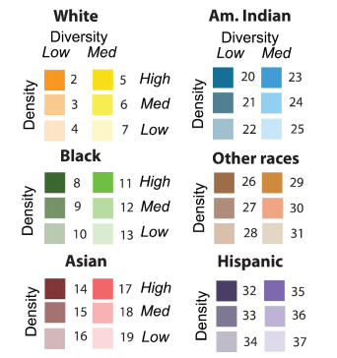
Racial Gerrymanders:
Why are they shaped this way
VRA: majority-minority districts
Illinois 4th
TX 35
Notes:
Sometimes, there is a reason behind the funny shape of a district.
A majority-minority district is a district in which the a majority of the population consists of a minority group. They often have funny shapes so that groups of people are connected. A perfect example of this is Illinois’s 4th Congressional District outside of Chicago. It is a coalition district and was intentionally drawn this way so that two separate hispanic populations, a Puerto Rican community in the north and Mexican community in the south, would have enough political cohesiveness as to elect a candidate of their choice. This was intended to be a good gerrymander; however, some claim that there were partisan intentions behind the district’s creation, ensuring that a democrat would maintain control of the district.
Now, let’s take a look at TX’s 35th Congressional District that spans between Austin and San Antonio. The purple in this map represents the Hispanic population. Note that the neck of this district only spans 4 miles across Interstate 35. The state claimed that they drew CD 35 to be a majority minority district. But in 2017, a federal court in San Antonio deemed CD 35 to be racially gerrymandered. They claimed that by “packing” hispanics into this district, they weekend their voting power state wide. However, in 2018, the Supreme Court overturned this ruling.

Slide 11
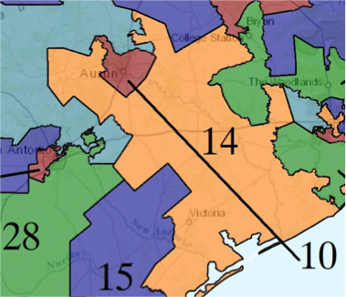
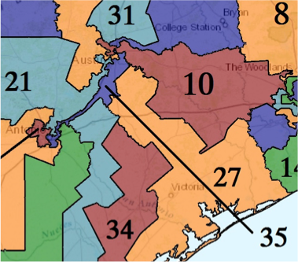
Cracking and Packing: Diluting Your Vote
1997 - 2002
2013 - Present
1990s
2017
Notes:
For a real life example of “cracking”, look no farther than Travis county and Congressional District 10. CD 10 had been a liberal-leaning district for more than a hundred years. In the 1990s, most of Travis County was still contained in this district. Then after the 2003 mid-census redistricting, Republicans started to split up Travis County, or “crack” it, and group it with rural, more conservative districts. This effectively watered down their vote.
In the present day maps, Travis county has been“cracked” amongst 5 districts that extend out into rural areas, some for hundreds of miles. Despite 62% of Travis county voting democratic in the 2016 general election, 4 out of 5 of these districts have a republican representative.

Slide 12
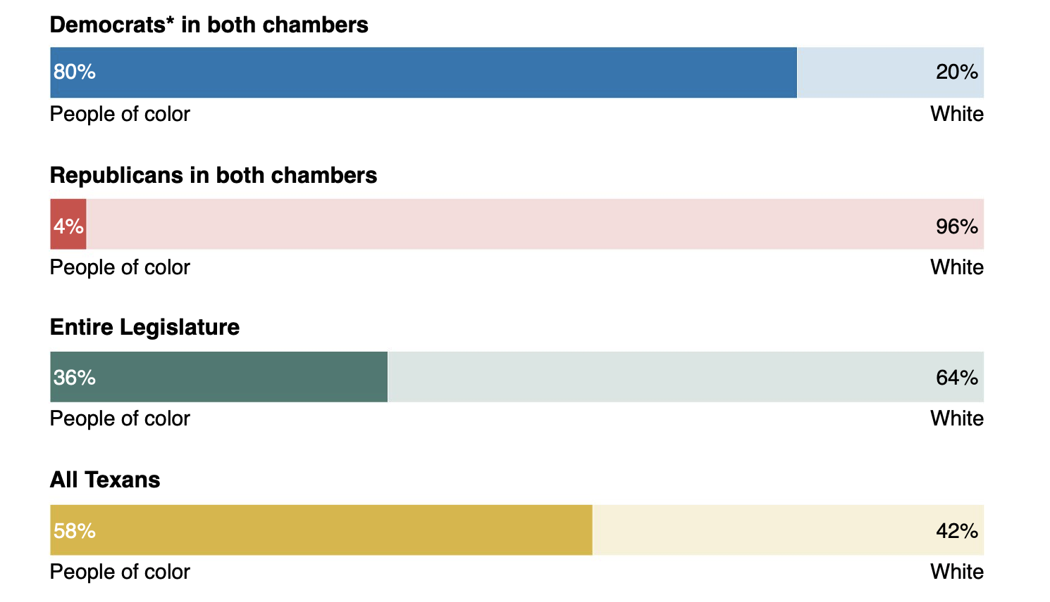
Legislature is less diverse than Texas as a whole
Notes:
The overall outcome of this sort of “partisan” gerrymandering has implications on the diversity of the Legislature. Despite the fact that 57% of TX’s population consists of people of color, only 36% if the Legislature consist of people of color. That skew is because of partisan gerrymandering.

Slide 13
Problems For Everyone
Legislators draw “safe”
districts for themselves
Election is moved from the
general to the primary
Incumbent re-elected
CANNOT hold Legislators
accountable
No compromising between parties
to capture votes
Hard to find a challenger,
races go uncontested
No choice at the ballot box,
Low voter turnout
Leads to Polarization
Notes:
THE MOST IMPORTANT SLIDE OF THE WHOLE PRESENTATION!
Politicians are drawing their own voting maps in order to manipulate elections to keep themselves and their party in power. They draw maps that have “safe” or uncompetitive districts. When they do this, the true race for the election moves from the general election to the primary. And in the primary, candidates no longer have to reach across the aise to compromise. In fact, candidates often times have to pander to the extremes of their party in order to win. This leads to polarization of the parties and ultimately gridlock in the Legislature.
The accountability of elected officials is also diminished. With the general election being determined in the primary, the general public can no longer hold these elected officials accountable in the general election. If they want to vote them out, they have to vote in the primary, and they sometimes have to cross party lines to do so. And with voter turnout in the primary being so low, this often means that candidates will be decided by as low as 10% of our population.
This system also makes it easier for incumbents to get re-elected. After a while, it becomes difficult to find challengers for these races, and, as a result, races go uncontested. This also leads to diminished voter turnout: Why show up to vote when you know who is going to win?

Slide 14
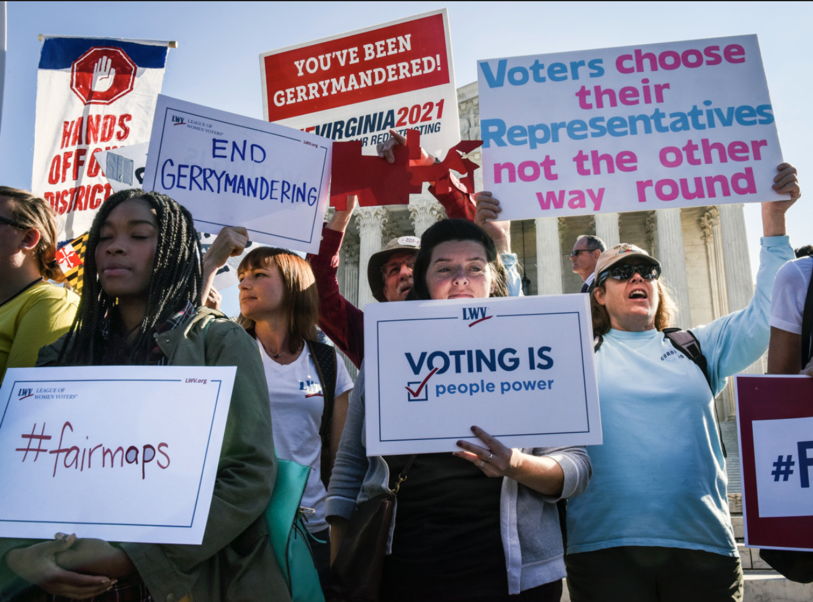
Rucho V League of Women Voters NC
Notes:
After all of this, you think the Supreme Court would step in and strike down partisan gerrymandering. Well, apparently they are not going to do so. In their recent ruling in Rucho v League of Women Voters North Carolina, SCOTUS decided that partisan gerrymandering was too much of a political question for them to get involved. Keep in mind that the Court has ruled extreme partisan gerrymandering to be unconstitutional. The problem is that they do not have an acceptable measure to tell the how much partisan gerrymandering is too much.

Slide 15
Nonpartisan Redistricting Commission
Many states are moving to this system.
Some commissions are composed of citizens.
Composition is balanced between Dems, Repub, Ind
Strict, nonpartisan criteria used to draw the districts
Public hearings, multiple review cycles with clearly defined timelines
IRCs ensure voters have a choice at the ballot box: In 2016, voters in all but 8% of the districts in states with commissions had two or more major party candidates on their congressional ballots.
WHAT WILL IT TAKE FOR TEXAS TO GET SUCH A COMMISSION?
Notes:
So, what can we do to fix the problem? Institute a nonpartisan redistricting commission. Many states are making the switch to this sort of commission. But keep in mind that most of the states that use this method of redistricting have access to the initiatives/ballot measures. In Texas, we do not have the initiative process. So, if we want to set up this sort of commission, we will have to pass legislation to do so. And for our state legislative maps, we will have to pass a constitutional amendment, which requires a 2/3 votes from both chambers of the legislature and a final vote by the public.
To give you an example of how such a commission is created and functions, let’s look at California’s Independent Redistricting Commission. Members of the Fair Maps Texas Coalition worked with legislators this past session to submit similar legislation to this model. The commission is balanced of partisanship with 5 democrats, 5 republicans, and 4 independents. The commissioners were selected after a lengthy vetting process that applied a strict list of conflicts of interest. You could not have been a legislator, worked for a legislator, contracted/consulted for a legislator, worked for a political party, donated more than $2500 to a candidate, nor could any of your family members done this. After the commission was selected, they held 33 public input hearings across the state and drew the maps based off of public testimony about their communities of interest. To help guide the commissioners, they followed a list of ranked district criteria. Maps were only drawn at the public hearings or in work sessions that were webcasted. And, commissioners were barred form communicating with legislators and lobbyists.

Slide 16
Public Input Hearings
Our Chance to Influence the Next District Maps!
Notes:
Why do we need districts anyways?
I want everyone to drop themselves back in time and imagine that they are setting up a town in west TX in the 1800s. What are some of the first things that you are going to need to find: maybe a water supply, a way to build houses and a way to grow food. Soon enough, maybe you have a line of transportation come by, like the railroad. Then grocery stores, businesses, and schools show up, and soon enough you have a town with a shared culture. This is what we refer to as a community of interest, and this community will need to have a cohesive voice of representation in order to advocate for shared needs and resources in their community.

Slide 17
TX Legislature’s Public Input Hearings
A community of interest is a contiguous population which shares common social and economic interests that should be included within a single district for purposes of its effective and fair representation.
You want to be able to effectively advocate for shared needs in your community!
Notes:
Texas also holds public input hearings.
The TX Legislature holds public input hearings across the state to hear from the public about what they want the next round of district maps to look like. Members of the Fair Maps Texas Coalition pushed the House Redistricting Committee to expand their list of cities where these public input hearings will be held. A complete list can be found on our website. These hearings are scheduled to begin in September 2019.

Slide 18
Nonpartisan Criteria For Maps and Testimony
Equal population
Comply with Voting Rights Act: partner with civil rights group
State House- County Line Rule
Communities of Interest:
Respect cities, counties, and neighborhoods
A community of interest is a contiguous population which shares common social and economic interests that should be included within a single district for purposes of its effective and fair representation.
Compactness: nearby areas of population are not bypassed for more distant population
Nesting: districts overlap

Slide 19
Examples of Communities of Interest
Culture or history
Transportation
Weather
Watershed
Economical regions (industrial, agricultural, tech, army, etc)
Recreational areas
Income status
Housing
Languages spoken
Schools
Healthcare areas and hospital districts
Common Goal: reducing crime or increasing jobs
Notes:
Be sure to look at the Redistricting Testimony Guide!!!

Slide 20
Technology Available
District Viewer:
dvr.capitol.texas.gov
DistrictR - MGGG:
districtr.org
Maptitude: Currently have 1 license that can be checked out

Slide 21
Past Legal Problems and the Closed Door Process
In every redistricting cycle in the last half-century, Texas has been found to have intentionally discriminated against racial minorities or violated the Voting Rights Act.
A federal court finding intentional discrimination in the 2011 process highlighted “[t]he exclusion of minority member and public input despite the minority population growth, the misleading information, the secrecy and closed process, and the rushed process.”
Recently the same panel of judges stated: “Given the record produced in 2011, the State must implement a process that, by any reasonable definition, is ‘fair and open.’”

Slide 22
Recommendations for Fair and Open Process
Recommendation 1: Hold a public hearing with public testimony on any proposed maps after they have been drawn, but before they pass through Committee. Provide adequate notice to the public about this hearing and an opportunity to review the maps before the hearing.
Explanation: Because of the timing census data is, it is not possible to draw maps until the legislative session is underway. In past cycles, the legislature has not held hearings on maps after they have actually been drawn. Any fair and open process should at the very least include the ability for public comment before a map is passed to a final vote of the legislature.

Slide 23
Recommendations for Fair and Open Process
Recommendation 2: Allow enough time at hearings for other legislators and the public to introduce alternative map suggestions.
Explanation: To demonstrate any problems with proposed maps, you have to show that better alternatives are possible. The redistricting committees are in control of how much and what type of testimony can be presented at a public hearing. The committees need to ensure that there is sufficient time and technical capability for alternative proposals to be examined which can help demonstrate flaws in the proposed maps.

Slide 24
Recommendations for Fair and Open Process
Recommendation 3: Explain how the maps were drawn, and why there was any deviation from traditional redistricting principles (e.g. county and precinct splits, population deviations). Include analysis of how these maps affect the ability of historically disenfranchised groups to elect candidates.
Explanation: Although it can be necessary to draw complicated districts to make fair and legal maps, deviating from traditional principles can also indicate unfair manipulation. A legislator who wishes to have a map adopted should be willing to explain why they made their choices and what process they followed in drawing their maps. Additionally, given Texas’s history of racial discrimination and Voting Rights Act violations, a legislator should include with any map an explanation of how their map affects the ability of minority communities to elect candidates of their choice.

Slide 25
Recommendations for Fair and Open Process
Recommendation 4: Don’t look at partisan data (data showing which political party people vote for) while drawing maps.
Explanation: Manipulating maps to artificially distort political power undermines the principle of a representative government. The government should represent a fair cross-section of society and partisan manipulation makes that impossible.

Slide 26
Recommendations for Fair and Open Process
Recommendation 5: Make all communications open regarding proposed maps.
Explanation: Legislators can try to hide behind “legislative privilege” to shield their communications from the public. Given the history of discriminatory redistricting and the federal court’s warning to engage in a fair and open process, legislative privilege should not be invoked when it comes to drawing maps. Any politician that wishes to have their map considered should be fully open and transparent about how and why they created their maps.

Slide 27
Demanding a Fair and Open Process
With the Legislature preparing to hold field hearings across the state, now is the chance for the community to make its voice heard.
Demanding a fair process now will set the stage for more concrete opportunities when it matters – the 2021 legislative session

Slide 28
Writing Testimony on Fair and Open Process
Introduce yourself to the Committee and state the topic of your testimony
Put into your own words how redistricting affects you and the issues that are important to you and your community.
Reference the broken process in the past and how it undermines principles of democracy when politicians choose their voters instead of voters choosing the politicians.
Make recommendations for improved process
Close

Slide 29
Questions to Consider:
How does your community or group interact with government at the state and US level?
Can you think of areas of common interest that you or your group have that might be impacted by legislation? For example, topics might include social, cultural, economic, ethnic or racial interests common to the population.

